Slide 1
Another Roundup 23
TR-C&NW a Rebirth: Yet Another Beginning
100 Percent NMRA
Three Lakes Model RR Club
January 16, 2023
Roger G Blocks, P.E.
NMRA #134321

Slide 2
Background in Model Rail
O Gauge Layouts 1946 - 1958 (childhood fun in Norwood Park, Chicago, IL)
HO Gauge Layout 1955-58 (never finished, also Norwood Park, Chicago, IL)
O Gauge Layout 1968 - 72 (for daughters & Neighbor kids, Newburgh, IN)
N Gauge Layout 1971-72 ( in mountains above the Newburgh, IN kids paradise)
O Gauge Layout 1974-78 (fun with children, Racine, WI)
N Gauge Layout 1980’s (table top: good fun, also Racine)

Slide 3
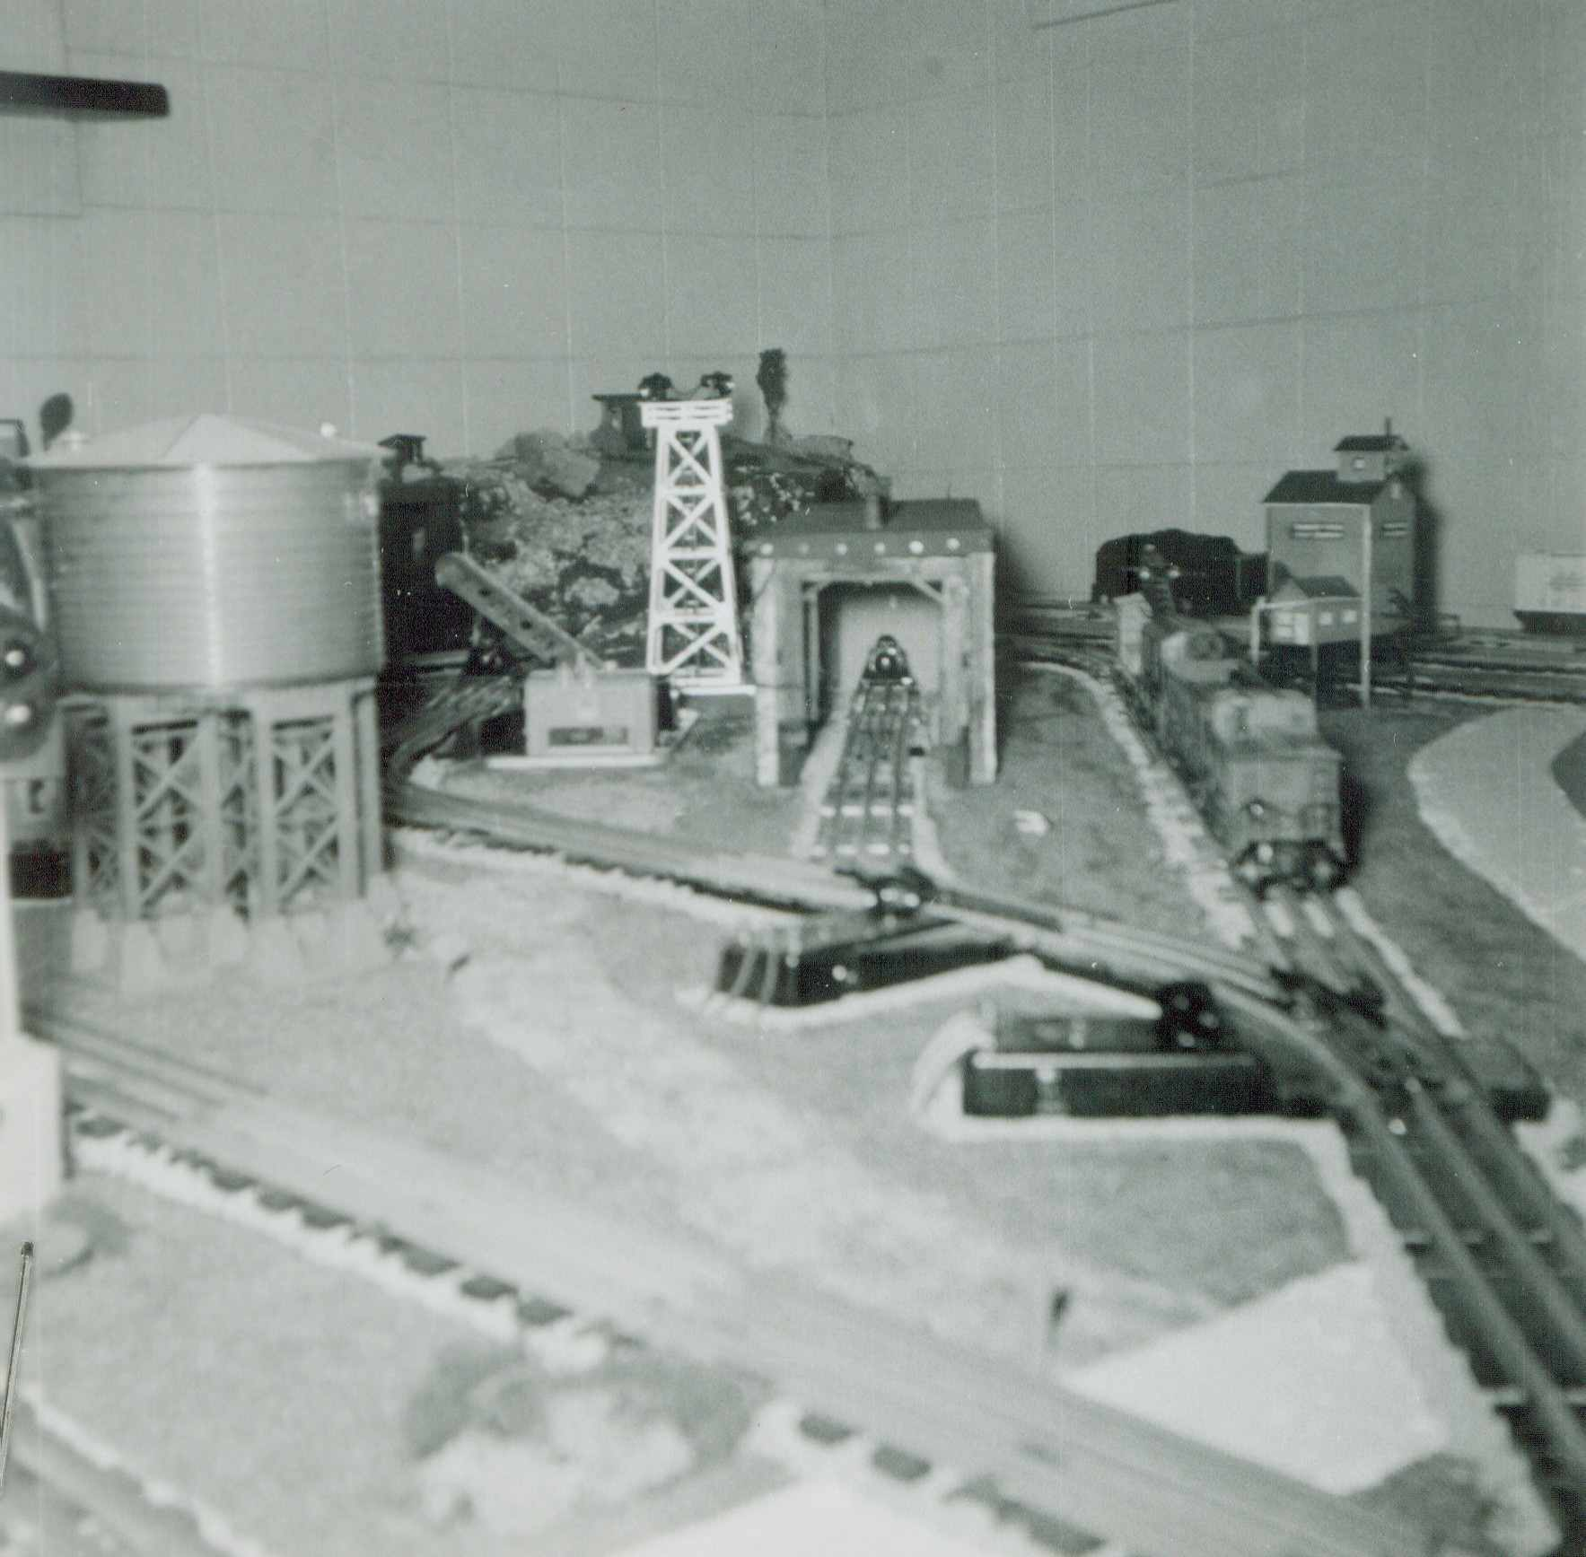
1946-58 Chicago, IL

Slide 4
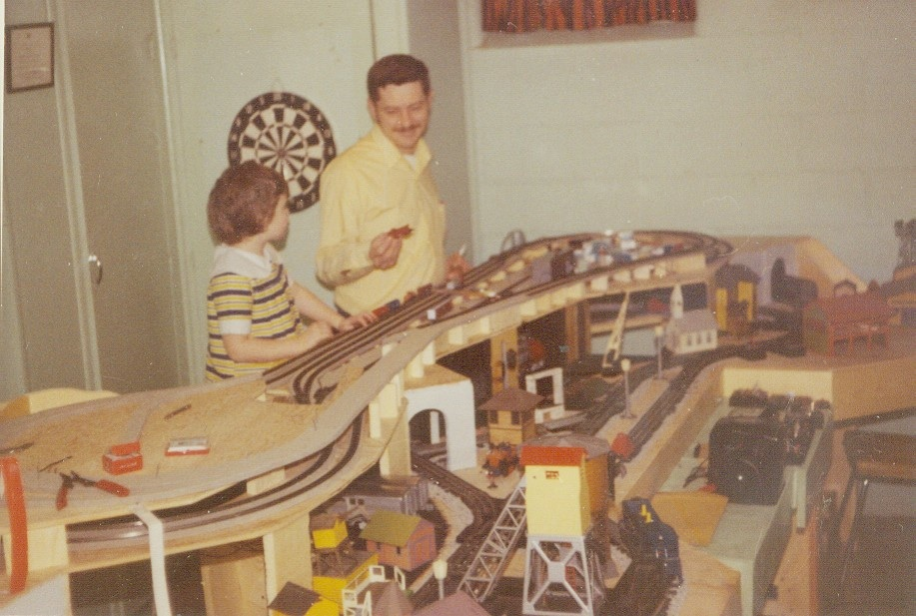
1968-72 Newburgh, IN

Slide 5
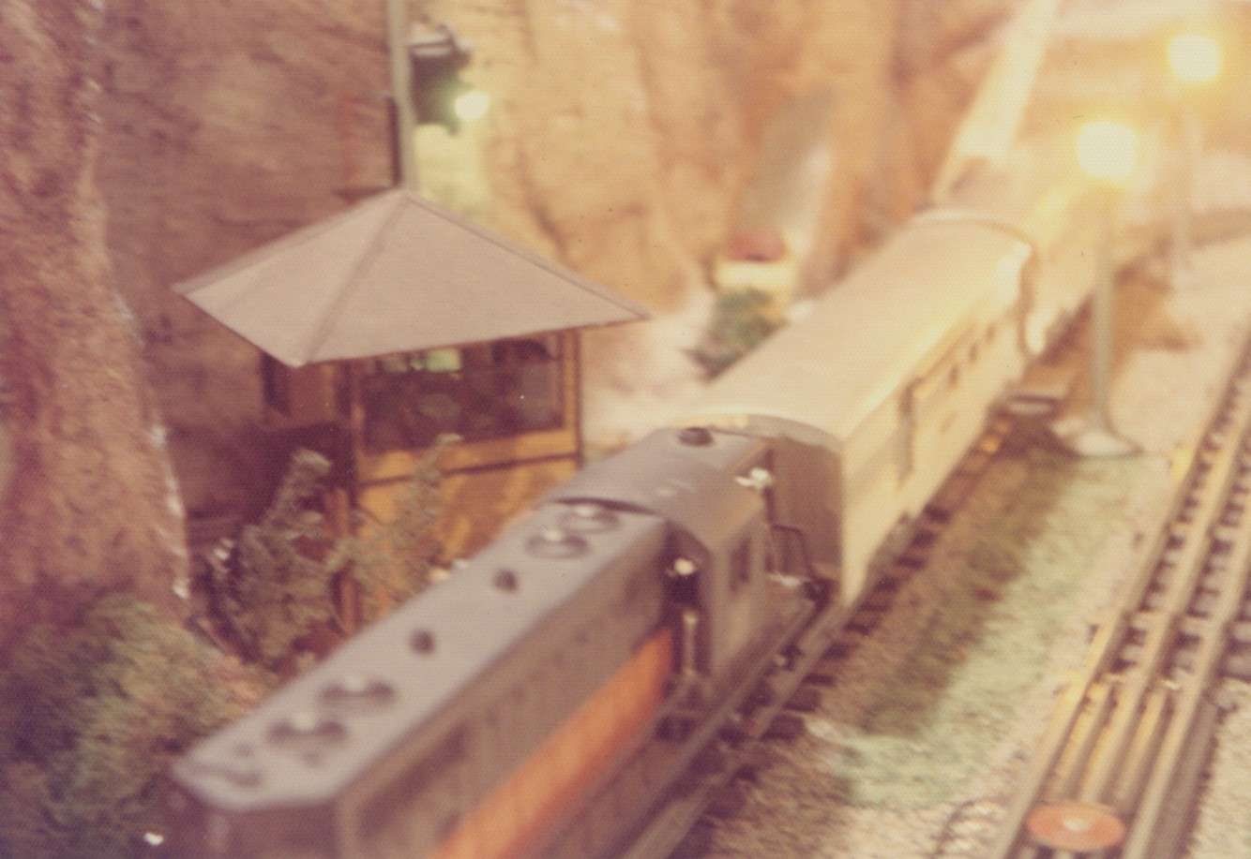
1968-72 Newburgh, IN

Slide 6
Nearing Retirement in 2004
Wife was retired from teaching RNs & consulting
I was taking history courses at UW Parkside
No longer flew to the Cape: Boeing took our work
Refinished our summer cottage: Three Lakes, WI
Had begun post retirement work (Racine Arson)
Trips: Rockies, Canada, England, Wales, Ireland

Slide 8
Activity Goals
Show Grandkids how to use tools
How to negotiate with adults
How to work together to achieve
The importance of sketches to explain a view
How electricity works
Practical stuff like plastering, wiring, assembling..
How to scrounge: save money, do without… etc

Slide 9
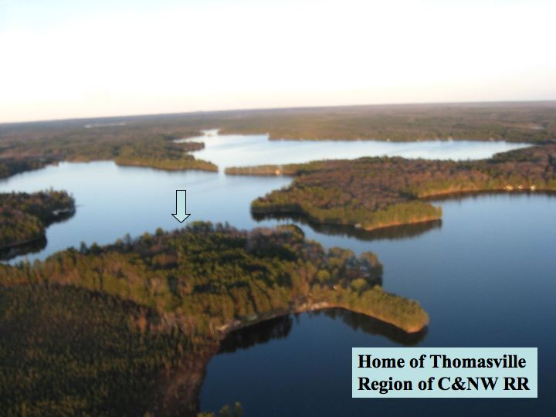

Slide 10
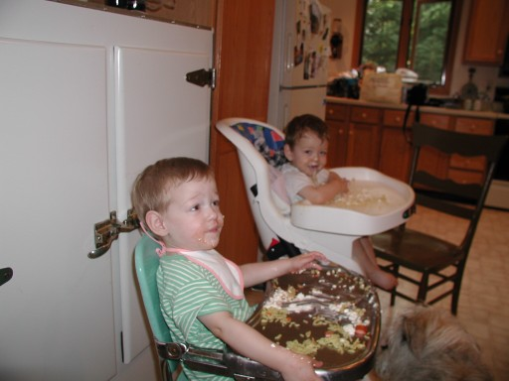
2003 Twins

Slide 13
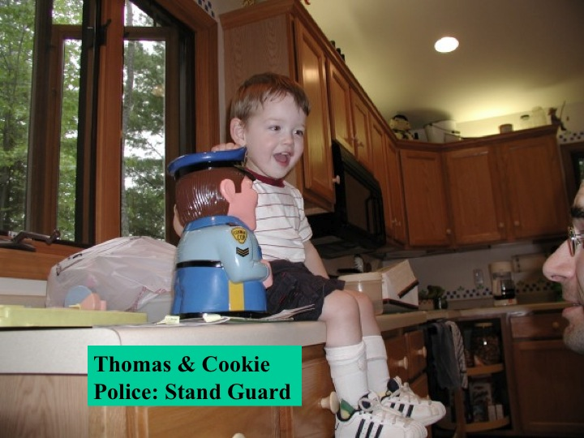

Slide 14
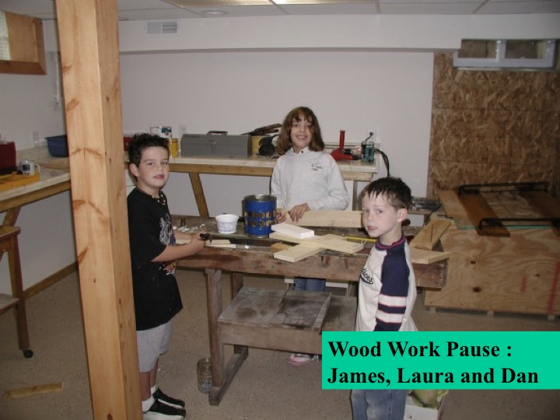

Slide 15
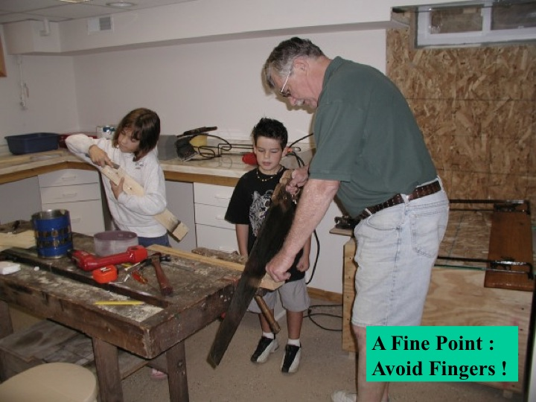

Slide 17
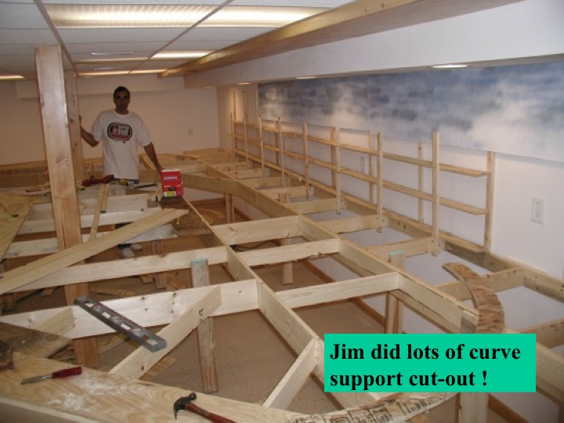

Slide 20
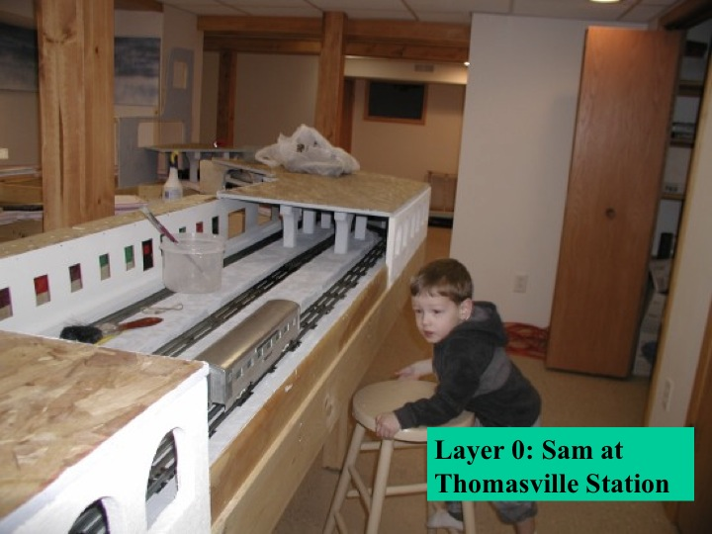
Semi-Monocoque

Slide 21
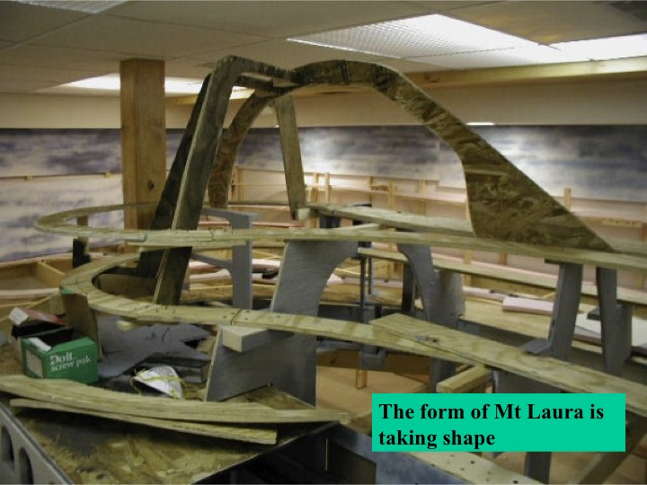

Slide 22
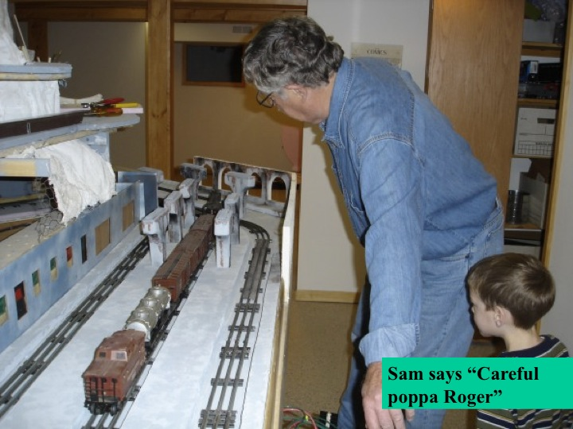

Slide 23
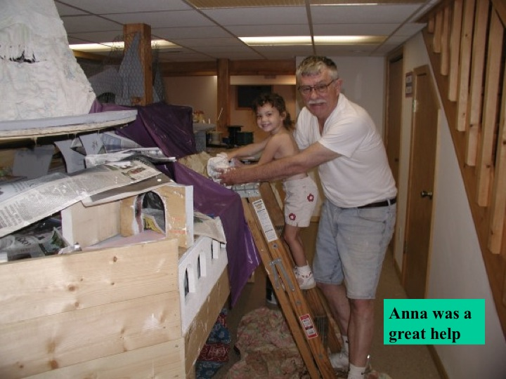

Slide 24
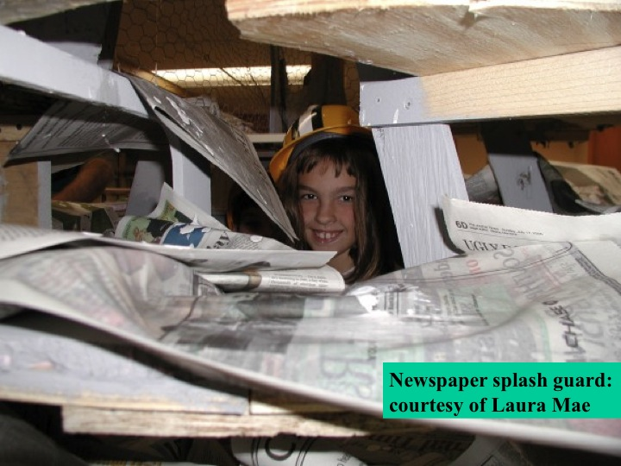

Slide 25
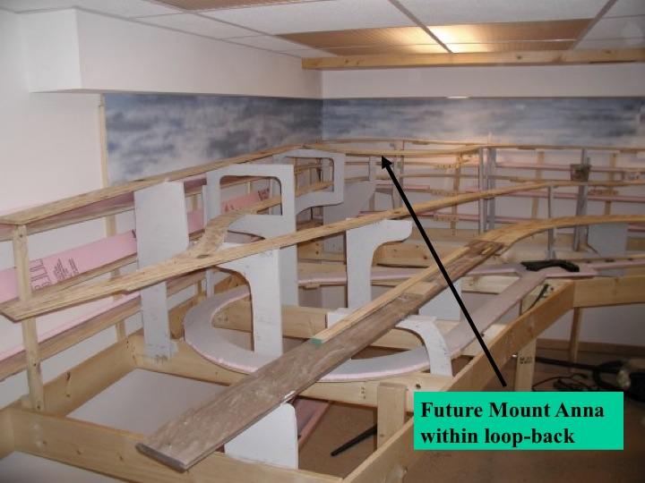

Slide 26
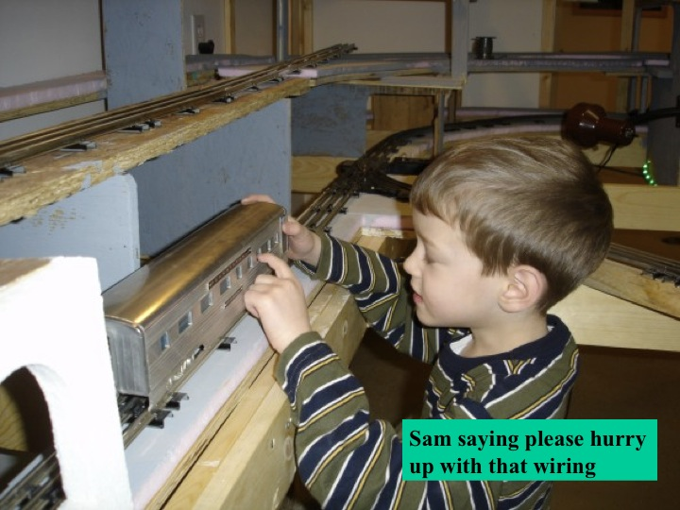

Slide 27
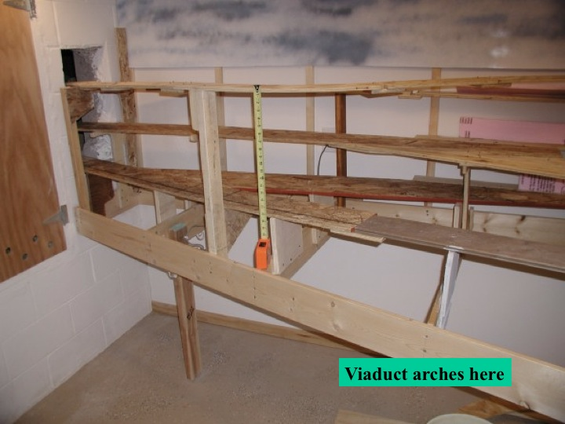

Slide 28
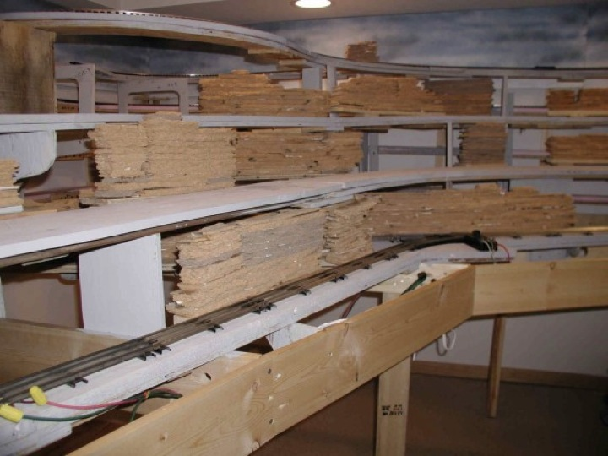

Slide 29
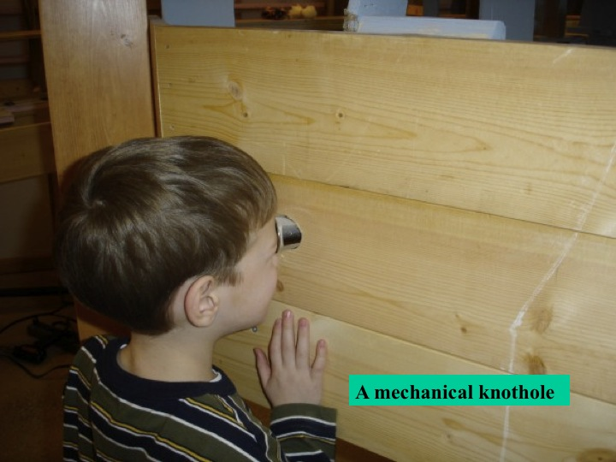

Slide 31
Play Trumps Work Anytime
Old Fashioned Barn Raising’s .. are social affairs
The trick is to turn work into fun.. food helps
Learning/ doing something in a short period helps
Making something together.. self satisfaction
Laughing with others .. sometimes at your mistakes
Let the other guy (kid) show you.. many ways to a goal
Objective is growth .. of hobbyist.. of child.. etc.

Slide 32
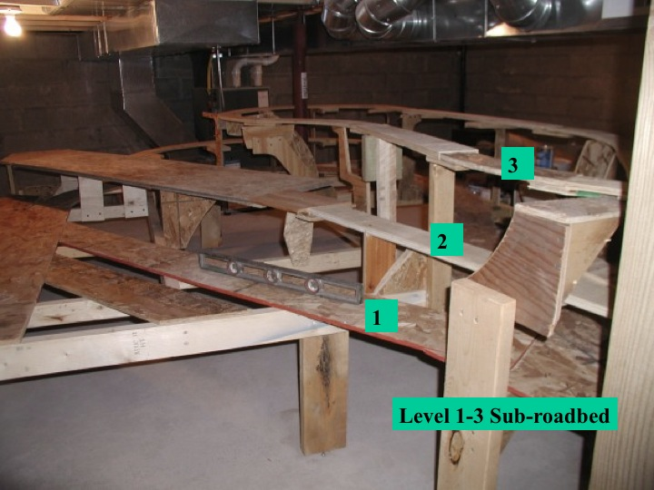

Slide 33
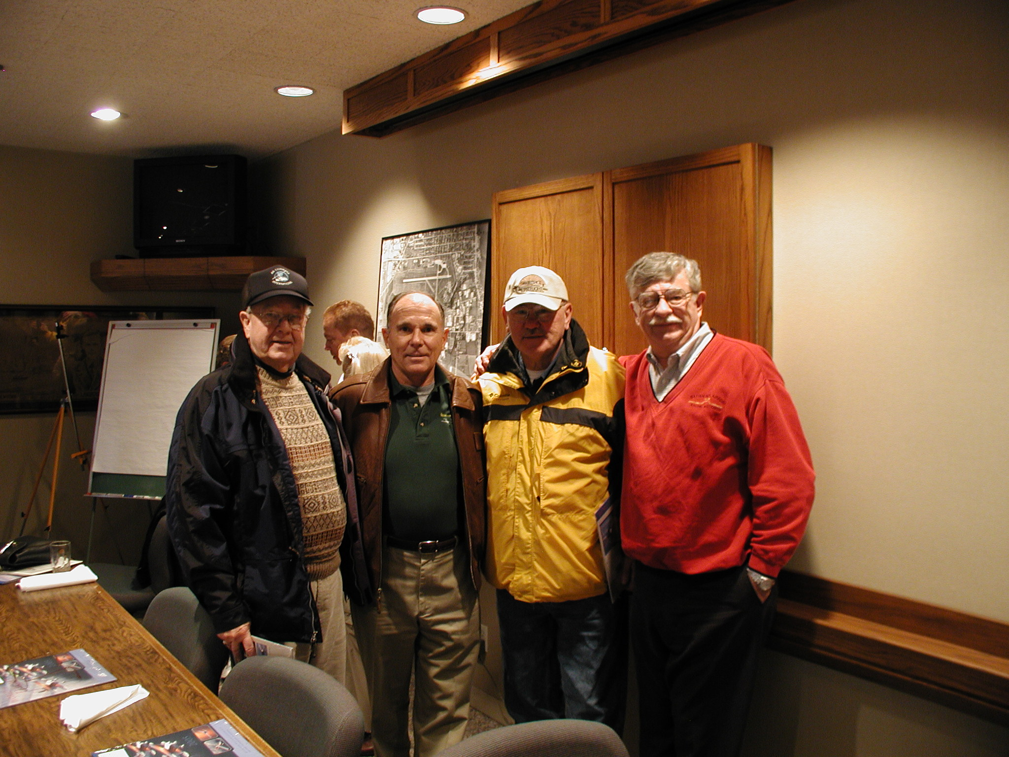
2005 Mike Melville (1st pilot
SpaceShip 1 & EAA Pals

Slide 34
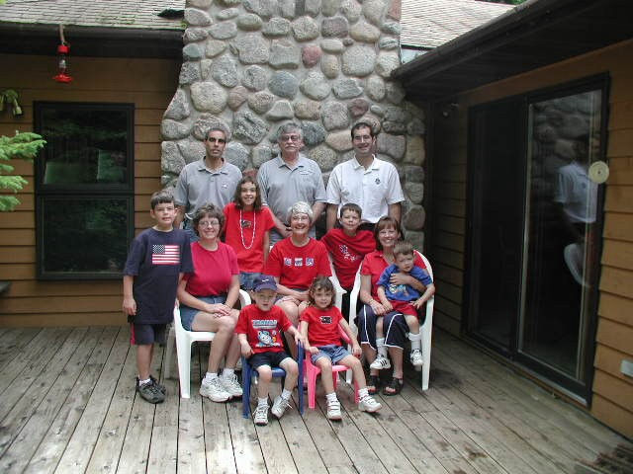
2005 our Family
My Crew

Slide 35
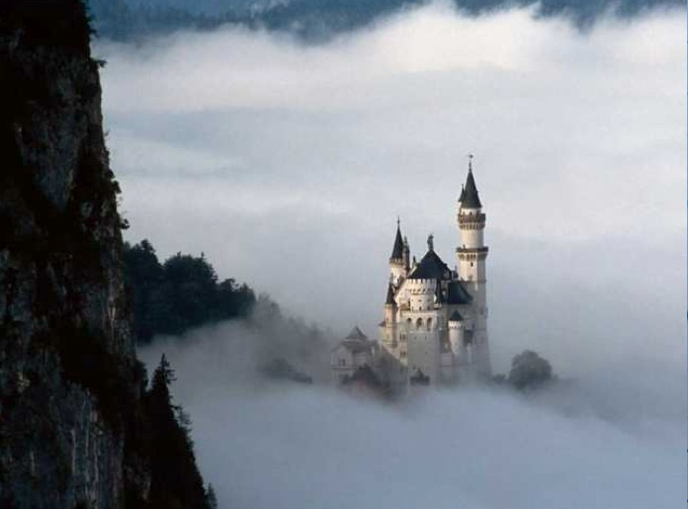
2005 Austria, Germany,
Luxemburg a diversion

Slide 36
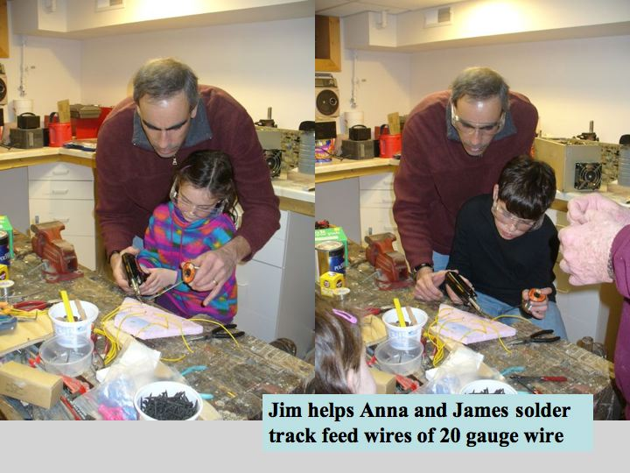

Slide 38
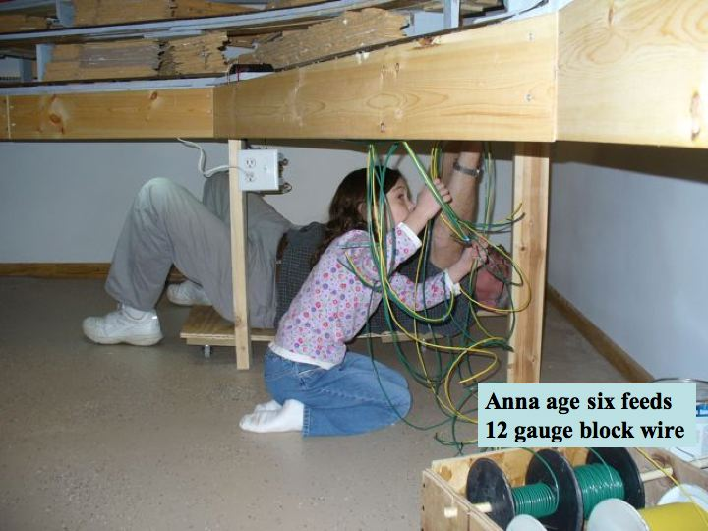

Slide 39
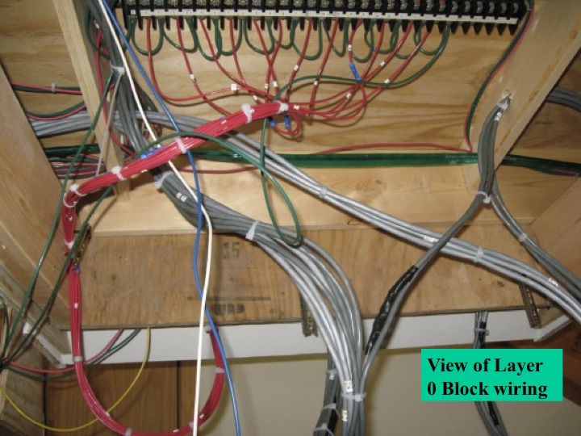

Slide 40
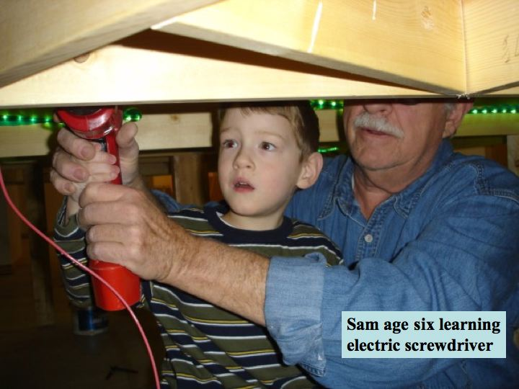

Slide 41
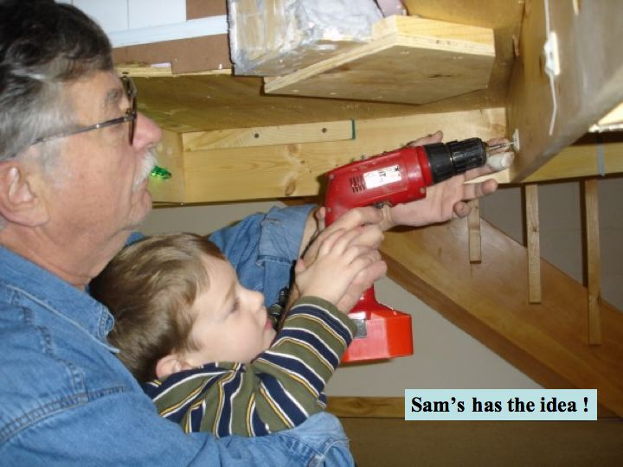

Slide 42
Noted in 2007

Slide 43
End of 2007 View

Slide 44
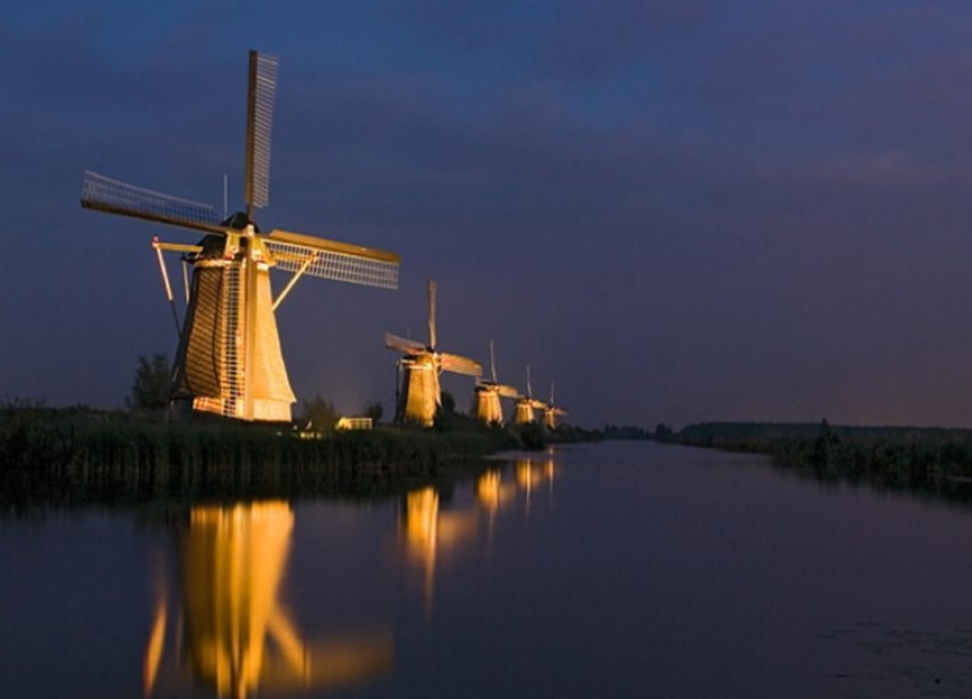
2007 Biking Holland
here Kinderdyke

Slide 46
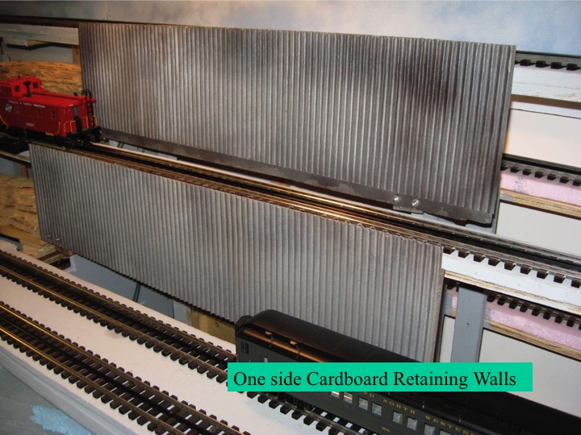

Slide 48
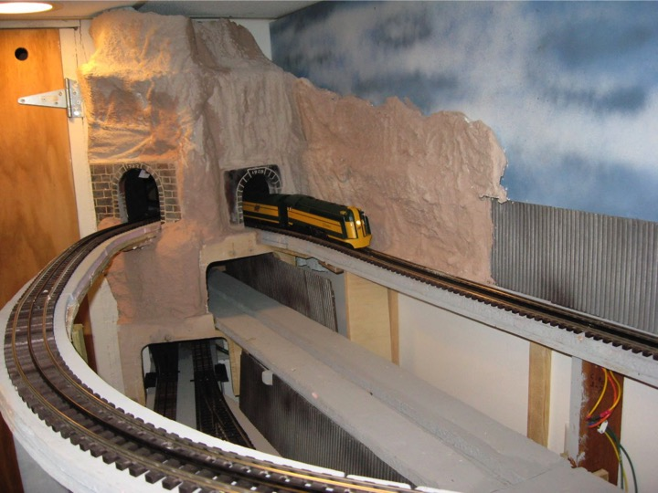
2004-2008 OutASite Mountain

Slide 49
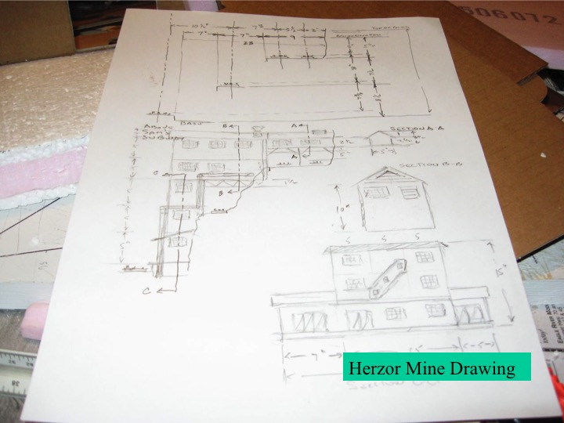

Slide 50
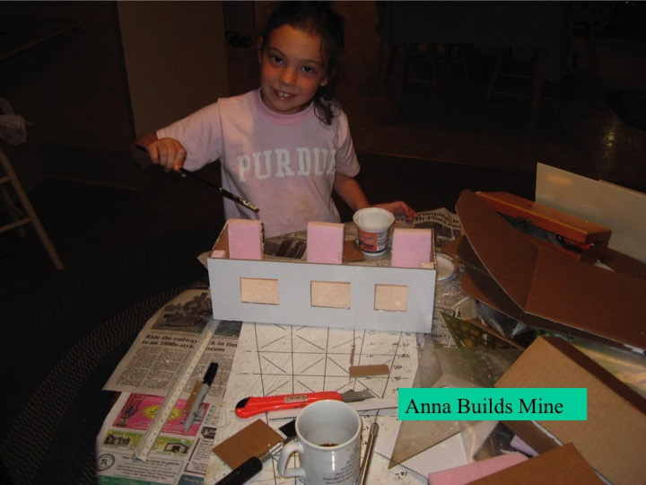

Slide 51
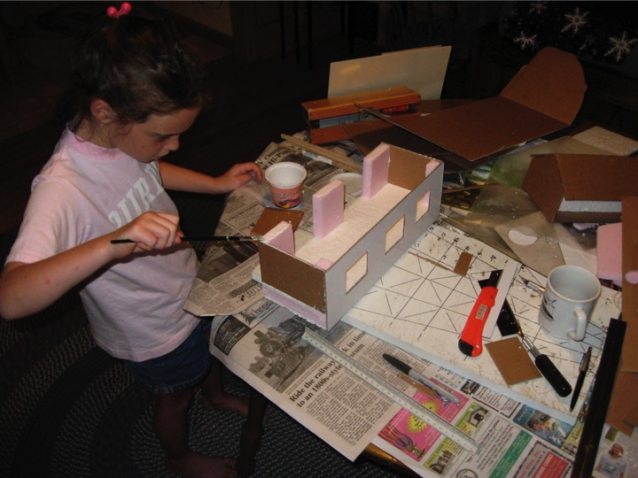

Slide 52
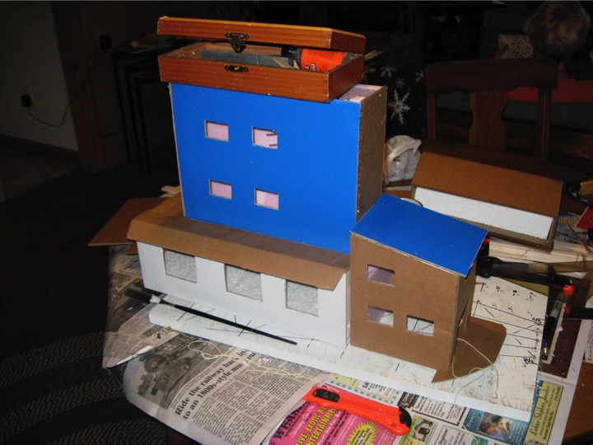

Slide 53
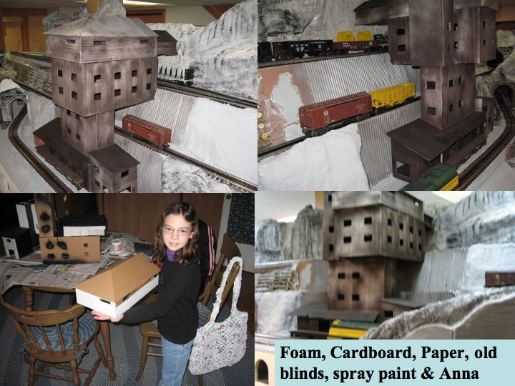

Slide 56
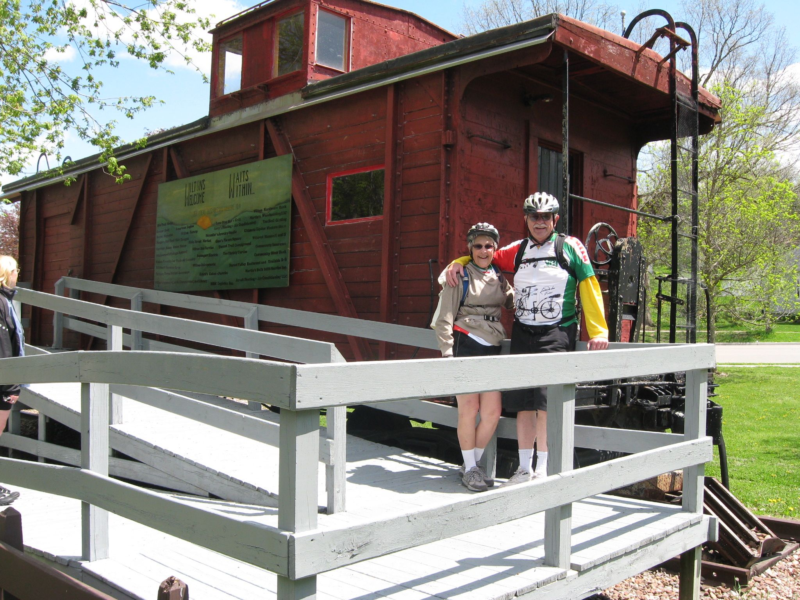
2009 Elroy - Sparta

Slide 57
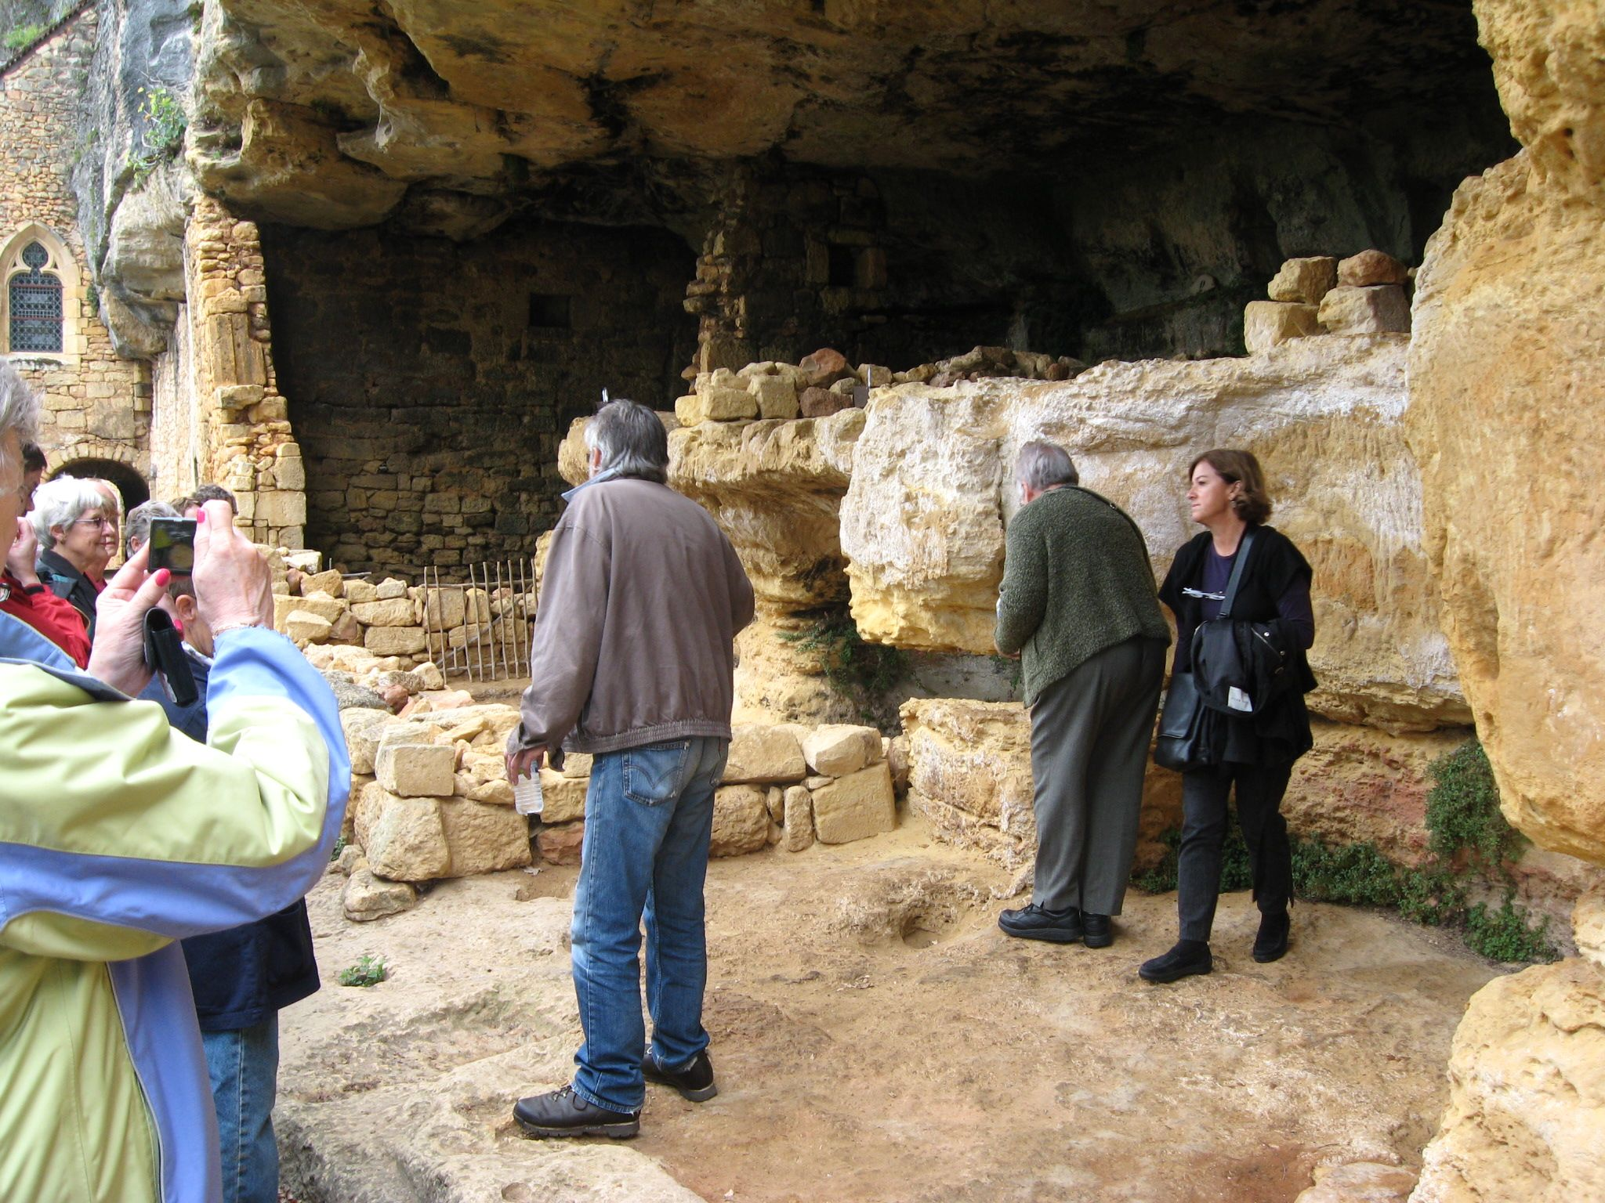
2009 France – Spain
Early man

Slide 58
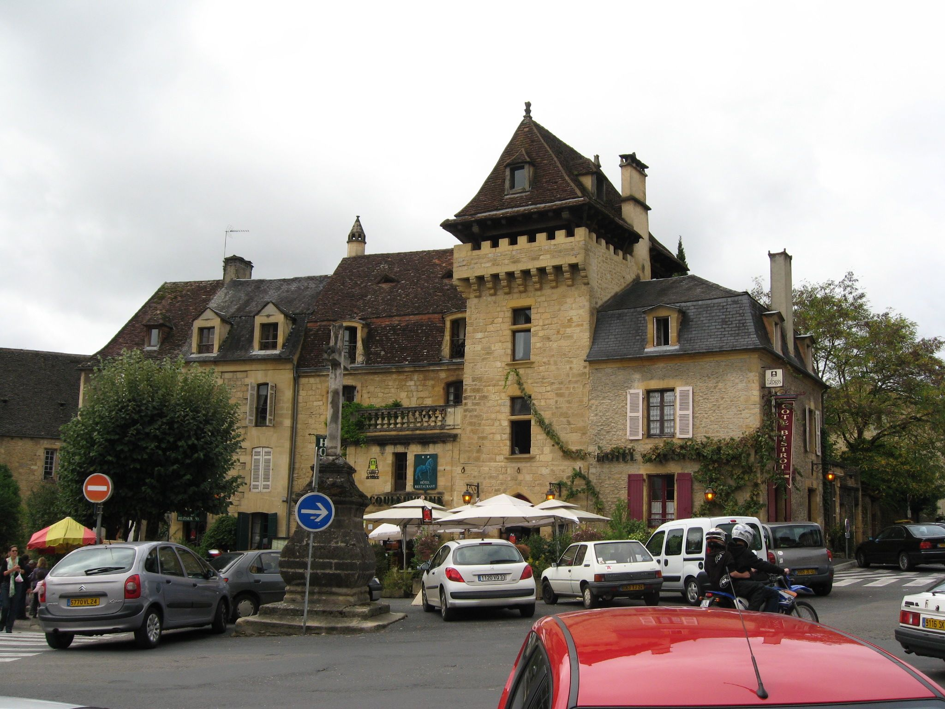
2009 Sarlat France

Slide 59
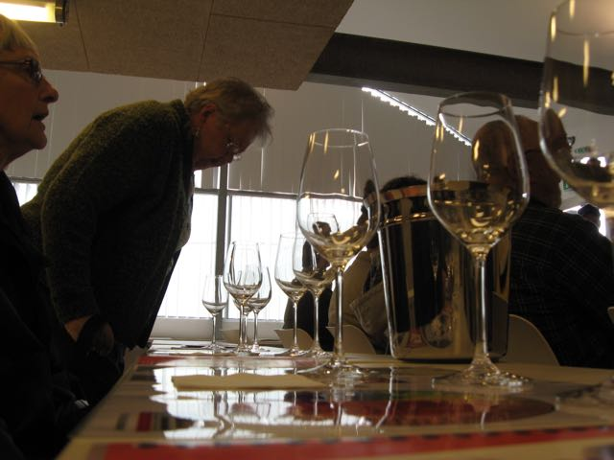
2009 Wine Tasting School

Slide 60
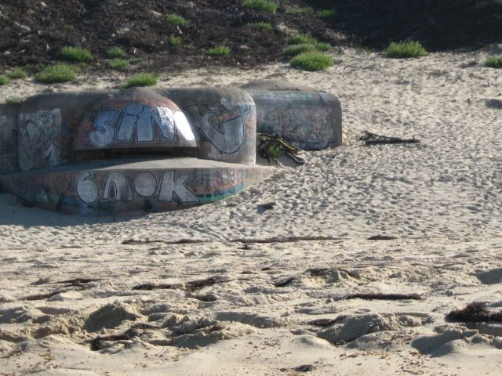
2009 Atlantic Wall

Slide 61
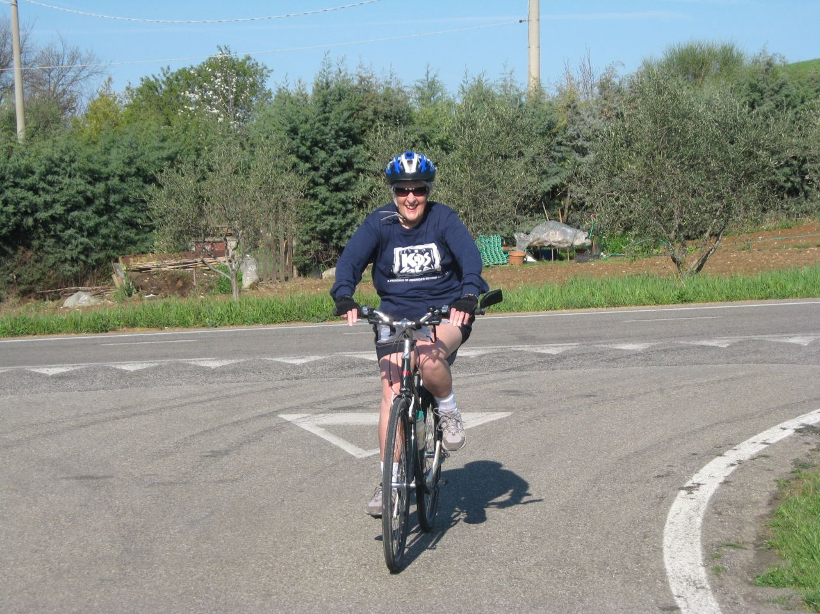
2009 Tuscany Biking

Slide 62
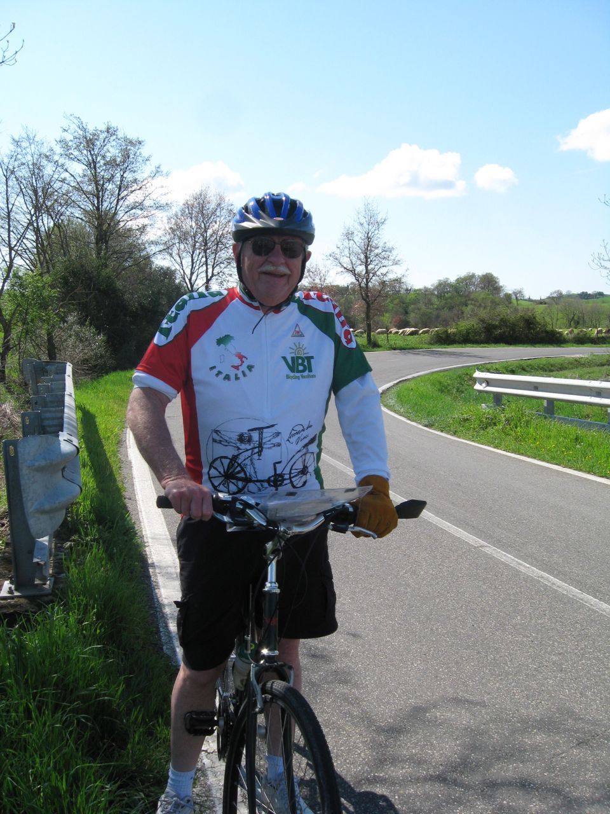
2009 Bike Tuscany

Slide 63
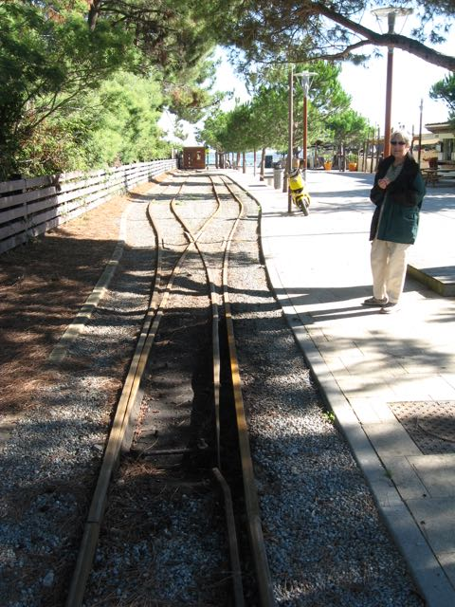
2009 Presqu' ile France

Slide 64
2009 Optimism Helps

Slide 67
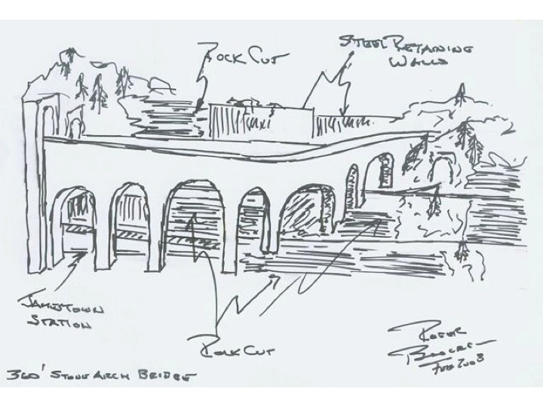

Slide 68
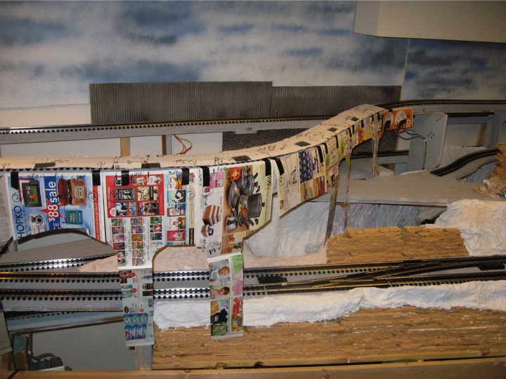

Slide 69
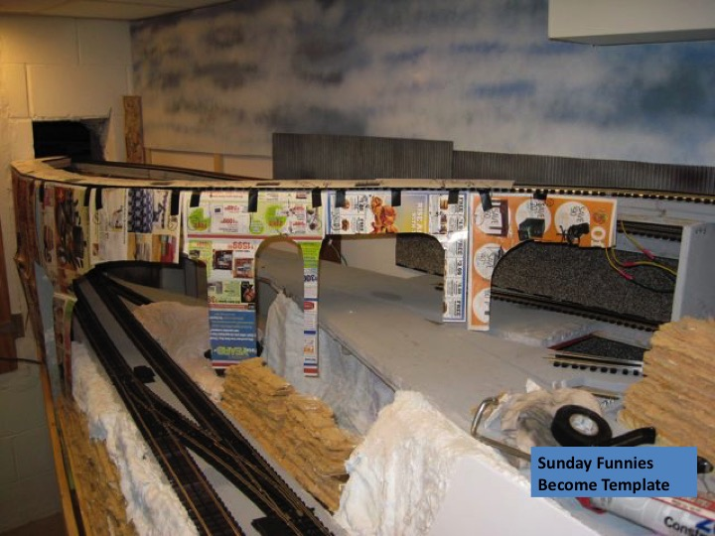

Slide 75
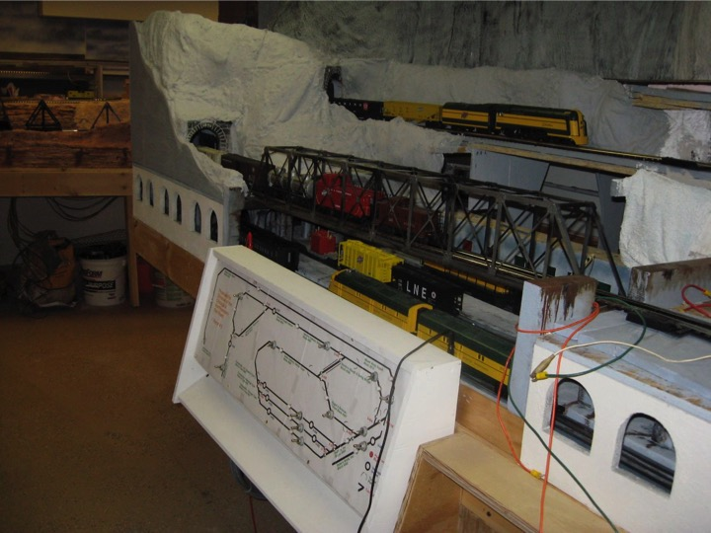

Slide 76
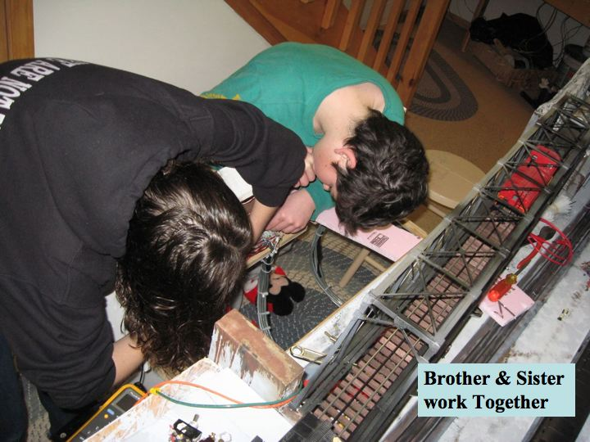

Slide 77
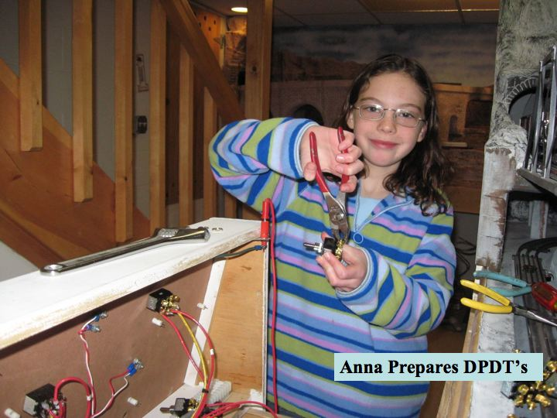

Slide 87
2010 Take TJ Flying

Slide 106
2011 GoldenSpike & Author

Slide 115
2011 Bike thru
and drink Piesporter
in Germany

Slide 116
2011 Drinking along the Mosel

Slide 117
2011 Konz Saarburgh

Slide 138
Anna’s Impact
Anna while the junior member
Has done wiring, plastering and Quality Assurance
And built Herzor-Mine with Grandpa Rog
and loves music, math... gets great grades.
Makes life better for all she knows

Slide 139
2012 – Heart Valve Fails
Marge’s Heart valve burned by radiation
Radiation was done after left breast cancer 1996
Looked at insertion of valve thru artery
Marge’s artery was too small in diameter
Open heart surgery thru her pericardium
Pericardium began to fail almost immediately

Slide 140
2012 Views Change

Slide 141
Marge’s Heart
2011 We biked 400 k up the Mosel River
2012 February a new Aortic Valve for Marge
2012 Shortness of breath: no more biking
2013 Oxygen limited, Pericarditus coontinues
2014 July bumps leg: ulcers begin: eliminate Chemo
2015 Hospital for Plural Cavity & Atrial Fib
2016 Expires 3x multiple hospitalizations

Slide 142
Rail Refocus
2012 Biking, hiking and dancing curtailed
2013 Doing what is important for life
2014 twenty five years of chemo are ending
2015 More important things than a railroad
2016 Little time to work on the railroad
2017 No interest in working on the TR-C&NW
2018 Things change!

